Slide 1
PART 2
RELATIONAL DATABASES

Slide 2
Chapter 5
Advanced SQL

Slide 3
Three Parts in Chapter 5
Accessing SQL From a Programming Language
  dynamic SQL, e.g. JDBC, ODBC, ADO, …
  Embedded SQL
Functions and Procedural（过程） Constructs
Triggers

Slide 4
5.1 Accessing SQL From a Programming Language
API, e.g.ODBC, JDBC, embedded SQL
Application program 1
DB file
Application program 2
DBMS
…
DB query language
e.g. SQL
Users
DBMS
DB
DBS/DBAS
Fig.5.0.1 DBS and DBAS
Notes:
如何使用通用程序设计语言访问SQL，这对于构建用数据库存取数据的应用有重要意义。
在应用程序中访问数据库的两种方式：
（1）动态SQL，如ODBC, JDBC等API；SQL在程序运行时被解释的。
（2）嵌入式SQL：必须在编译时全部确定，并交给预处理器。预处理程序提交SQL到数据库系统进行预编译和优化，然后把应用程序中的SQL语句替换成相应的代码和函数，最后调用程序中的编译器进行编译。

Slide 5
Accessing SQL From a Programming Language
API (application-program interface) for a program to interact with a database server
Application conducts complex data processing, and makes calls to
  Connect with the database server
  Send SQL commands to the database server
  Fetch tuples of result one-by-one into program variables
Various tools:
  JDBC (Java Database Connectivity) works with Java
  ODBC (Open Database Connectivity) works with C, C++, C#, and Visual Basic
  Other API’s such as ADO.NET sit on top of ODBC
  Embedded SQL

Slide 6


Slide 7
5.1.1 JDBC
JDBC is a Java API for communicating with database systems supporting SQL.
JDBC supports a variety of features for querying and updating data, and for retrieving query results.
JDBC also supports metadata retrieval, such as querying about relations present in the database and the names and types of relation attributes.
Model for communicating with the database:
  Open a connection
  Create a “SQL statement” object
  Execute queries using the Statement object to send queries and fetch results
  Exception mechanism to handle errors
Notes:
Java程序必须引用java.sq.*，它包括了JDBC所提供功能的接口定义。

Slide 8
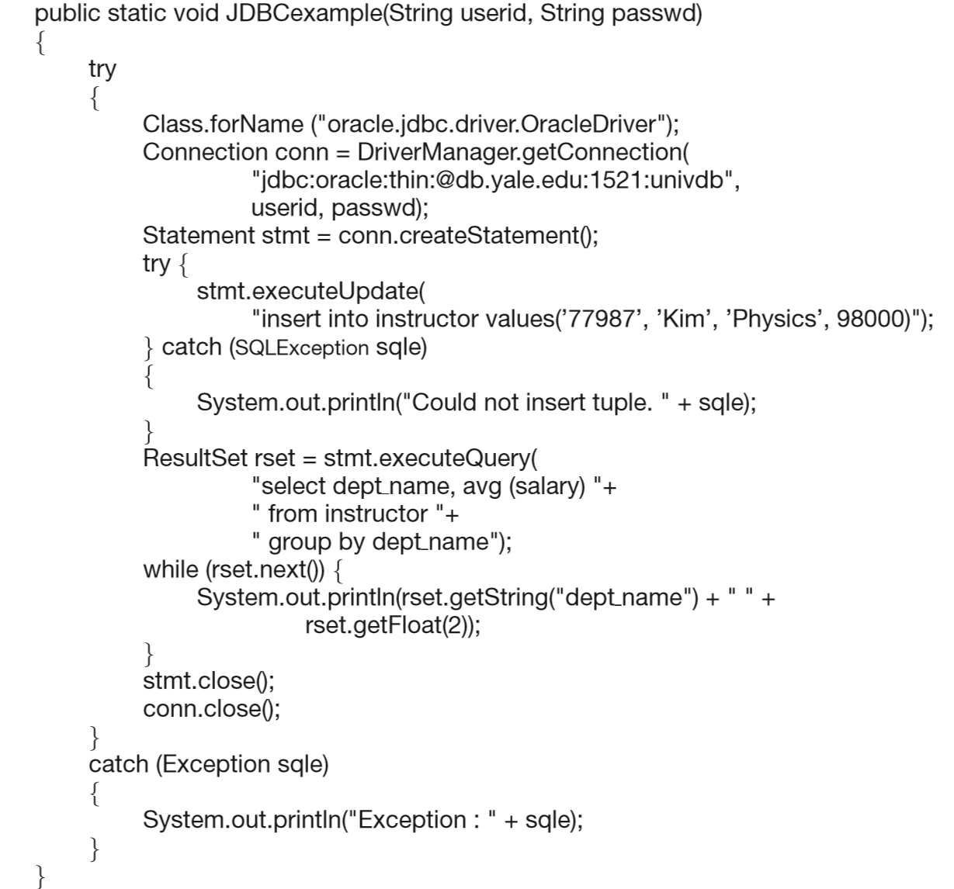
Fig.5.1 A JDBC Example

Slide 9
JDBC
Open a connection, named as conn
  using the getConnection method of the DriverManager class
  parameters
  URL/machine to be connected;
  user identifier, password
  Create a SQL “statement” object on the connection conn
  using the createStatement method
  its statement handle is named as stmt
  allows the Java program to invoke（调用） methods that ship an SQL statement given as an argument （函数调用时的实际参数）for execution by the DBMS
Notes:
可以调用stmt对象变量的一些方法，通过参数传递SQL语句并被数据库系统所执行，从而实现查询和更新数据，以及获取查询结果。

Slide 10
JDBC
  Execute queries using the Statement object stmt to send queries and fetch results
  using execute.query or execute.update such as insert/delete/update/createtable
  parameters
  the SQL statement to be executed, represented as a string
  using the try{…}/catch{…}construct to catch any exceptions or error conditions

Slide 11
JDBC
  Fetch the query result
  retrieve the set of tuples in the result into a ResultSet object rset, and fetch them one tuple at a time
  the next() method tests whether or not the result set has at least one tuple and if so, fetches it
  At the end of the query, the statement stmt and the connection conn are closed

Slide 12
5.1.2 ODBC
Open DataBase Connectivity (ODBC) standard
  standard for application program to communicate with a database server.
  application program interface (API) to
    open a connection with a database,
    send queries and updates,
    get back results.
Applications such as GUI（图形用户界面）, spreadsheets, etc. can use ODBC

Slide 13
Data Source
Name
Database application programs
Application
Level
ODBC API
ODBC manager
ODBC
Level
ODBC driver manager
SQL Server
driver
Oracle
driver
Sybase
driver
other DB
driver
SQL
Server
Oracle
Sybase
other
DBMS
Data Source
Level
Fig.5.0.2 ODBC Architecture

Slide 14
§5.4 Embedded SQL
Approaches to take SQL as DB query tools
  interactive SQL
    SQL is used directly as DML and DDL through DBS human-machine interfaces
  dynamic SQL, e.g JDBC, ODBC
  embedded SQL
    SQL is embedded in general-purpose programming languages, e.g. C language
    executing of general-purpose programming language programs with SQL statement embedded results in DB access

Slide 15
Embedded SQL
The SQL standard defines embeddings of SQL in a variety of programming languages such as C, C++, Pascal, Fortran, and Cobol
A language to which SQL queries are embedded is referred to as a host language(宿主语言), and the SQL structures permitted in the host language comprise embedded SQL
Merits of embedded SQL
  交互式SQL只能进行DB的访问操作，不能对DB访问结果进行进一步的数据处理
  Embedded SQL将SQL的数据库访问功能与C语言等宿主语言的数据处理能力相结合，提高了数据应用系统的能力

Slide 16
Embedded SQL
EXEC SQL statement is used to identify embedded SQL request to the preprocessor
EXEC SQL <embedded SQL statement >;
Note: this varies by language:
  In some languages, like COBOL, the semicolon（分号） is replaced with END-EXEC
  In Java embedding uses # SQL { …. };

Slide 17
Embedded SQL (Cont.)
Before executing any SQL statements, the program must first connect to the database. This is done using:
EXEC SQL connect to server user user-name using password;
Here, server identifies the server to which a connection is to be established.

Slide 18
Embedded SQL (Cont.)
Variables of the host language can be used within embedded SQL statements. They are preceded by a colon (:) to distinguish from SQL variables
  e.g., :credit_amount
Variables used as above must be declared within DECLARE section, as illustrated below. The syntax（语法） for declaring the variables, however, follows the usual host language syntax.
EXEC-SQL BEGIN DECLARE SECTION;
int credit-amount ;
EXEC-SQL END DECLARE SECTION;

Slide 19
Embedded SQL (Cont.)
E.g.1 From within a host language, find the ID and name of students who have completed more than the number of credits stored in variable credit_amount in the host langue
  credit_amount is the shared variable defined in the declaration part

Slide 20
C program
  EXEC SQL BEGIN DECLARE SECTION
  int credit_amount;
EXEC SQL END DECLARE SECTION
credit_amount := e.g. input-from-screen-by-users
EXEC SQL
  select ID, name
  from student
  where tot_cred > :credit_amount
END-EXEC
shared variable defined in host language

Slide 21
Cursor（游标） in Embedded SQL
To write an embedded SQL query, we use the
declare c cursor for <SQL query>
statement.
The variable c is used to identify the query
EXEC SQL
declare c cursor for
select ID, name
from student
where tot_cred > :credit_amount
END_EXEC
Notes:
为了表示关系查询，声明游标，控制结果元组的获取顺序。
用变量c表示一个查询的游标，该变量用来表示该查询。

Slide 22
why using Cursor in Embedded SQL
利用Embedded SQL进行查询时，查询结果有可能包括多个元组，此时无法直接将多个元组通过共享变量赋值传递给宿主程序
系统开辟专门working区域存放SQL查询的结果关系（也称作中间关系），并利用查询游标c指向此区域。宿主程序根据c指向的查询结果关系集合，使用open, fetch, close依次获取结果关系中的各元组

Slide 23
EXEC SQL BEGIN DECLARE SECTION
  int credit_amount;
  char si, sn;
EXEC SQL END DECLARE SECTION
credit_amount:= input-from-screen-by-users
EXEC SQL
declare c cursor for
  select ID, name
  from student
  where tot_cred > :credit_amount
END-EXEC
EXEC SQL open c END-EXEC
EXEC SQL fetch c into :si, :sn END-EXEC
EXEC SQL close c END-EXEC
Example 2
可以用循环语句依次取走全部查询结果
shared variable
Notes:
结果集中每个元组的各个属性需要分别赋值给程序中的变量。
Close c：删除中间关系
Fetch c: 一条单一的fetch请求智能得到一个元组，open语句执行后，游标指向结果的第一个元组，执行一条fetch语句后，游标指向结果集的下一个元组。
Open c: 执行查询，并把结果存放在一个临时关系中，open语句执行时，宿主变量的值就会被应用到查询中。

Slide 24
Cursor in Embedded SQL (cont.)
Usage of cursor in embedded SQL
declare cursor – open – fetch - close
application program:
open
fetch
close
SQL query
cursor
working area
DBS
results
…
Fig. 5.0.3 Cursor in Embedded SQL

Slide 25
Cursor in Embedded SQL (cont.)
The open statement for our example is as follows:
EXEC SQL open c ;
This statement causes the database system to execute the query and to save the results within a temporary relation. The query uses the value of the host-language variable credit-amount at the time the open statement is executed.
The fetch statement causes the values of one tuple in the query result to be placed on host language variables.
EXEC SQL fetch c into :si, :sn END_EXEC
Repeated calls to fetch get successive tuples in the query result

Slide 26
Cursor in Embedded SQL (cont.)
A variable called SQLSTATE in the SQL communication area (SQLCA) gets set to ‘02000’ to indicate no more data is available
The close statement causes the database system to delete the temporary relation that holds the result of the query.
EXEC SQL close c ;
Note
  above details vary with language
  for example, the Java embedding defines Java iterators(迭代器） to step through result tuples.

Slide 27
§5.3 Trigger (触发器)
Trigger
  a statement that is executed automatically by DBMS as a side effect of a modification to the database
As an integrity control mechanism, trigger introduced to SQL standard in SQL:1999, but supported even earlier using non-standard syntax by most databases.
  Syntax illustrated here may not work exactly on your database system;
  check the system manuals
Notes:
触发器：用来实现未被SQL约束机制指定的某些完整性约束。是一种非常有用的机制，用来当满足特定条件时对用户发出警报或自动开始执行某项任务。

Slide 28
8.6 Trigger (cont.)
Trigger is an event-condition-action model based integrity definition, checking, remedy（更正） mechanism
  specify what events cause the trigger to be executed (e.g. insert, delete, update), and under which conditions the trigger execution will proceed（继续）
    integrity constraints checking
  specify the actions to be taken when the trigger executes
    if constraints is violated, remedy actions are taken
Notes:
要设置触发器机制，必须满足两个要求：
（1）指定什么条件下执行触发器，被分解为一个引起触发器被检测的事件和一个触发器执行时必须满足的条件；
（2）指明触发器执行时的动作。

